Slide 1
ABH Network Provider Administrative Training
April 9th, 2026 1200 - 1400
April 10th, 2026 0900 - 1100
Our Mission: Helping People

Slide 2
Housekeeping
Please enter the following into the chat box:
Name
Credentials
Organization and
Email address

Slide 3
Closed Captioning
Please enable captions in Zoom
Select “More” at the top of your screen
Select “Language & Speech”
Select "Show Live Captions"
You will now see closed captioning along the bottom of your screen

Slide 4
Medicaid and Health Plan Updates

Slide 5
New Contract & Re-procurement Updates

Slide 6
NCQA Re-Accreditation Update

Slide 7
Claims/Billing
Paper Claims Billing address
Access Behavioral Health
ATTN: Claims
1221 West Lakeview Avenue
Pensacola, FL 32501
Paper Claims Billing address
Electronic Claims

Slide 8
Claims/Billing
Reimbursable behavioral health Dx codes: F01.50 – F53.1; F55.0 – F63.9; F68.10 – F69; F80.82, F88 – F99; Z03.89 (F84.0 - Autism is not a covered diagnosis)
Claims payment questions:
(850) 469-3631; abhbilling@lifeviewgroup.org
Linda Gibbs, RHIA, Director of Reimbursement Services
Direct Deposit Application will be sent out via documents

Slide 9
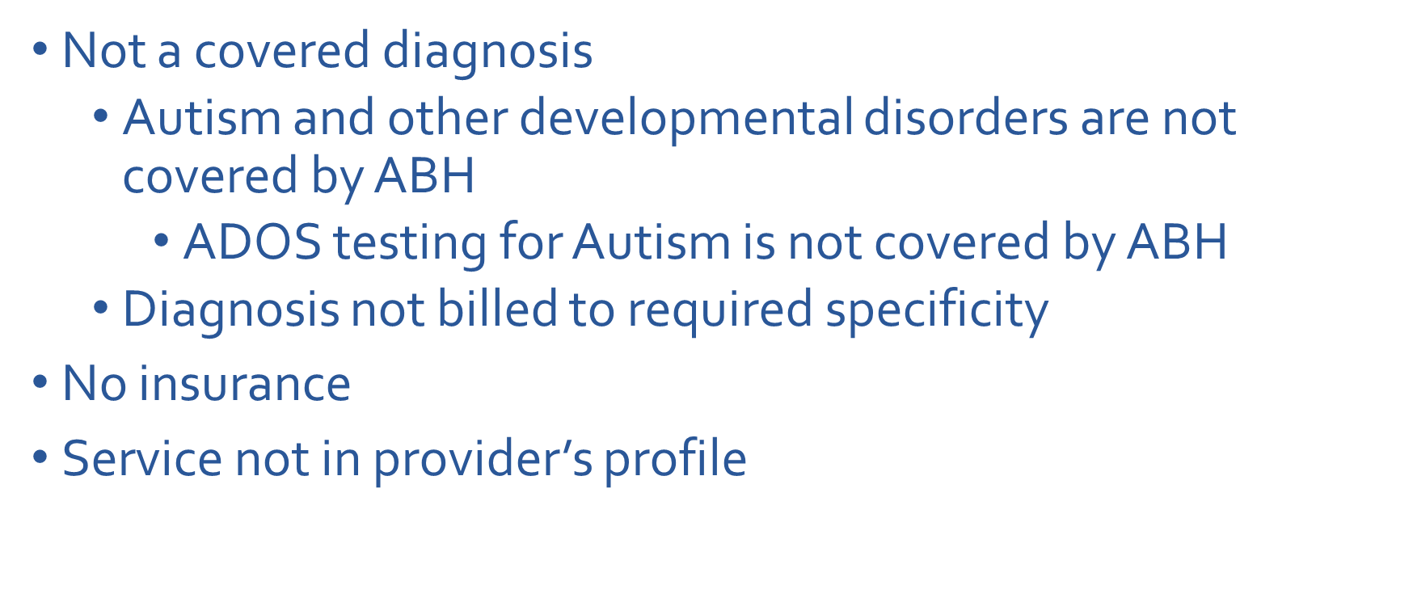
Common Denial Reasons

Slide 10
Claims Provider Portal
Requires a brief training/ facility username and password
Check member eligibility
Check claims status
Obtain weekly remittance advice (EOB)
Coming next: the HCFA 1500 form is now available in the portal for end-users to directly key claims
Contact Jon Hawkins for assistance ABHITSupport@lifeviewgroup.org

Slide 11
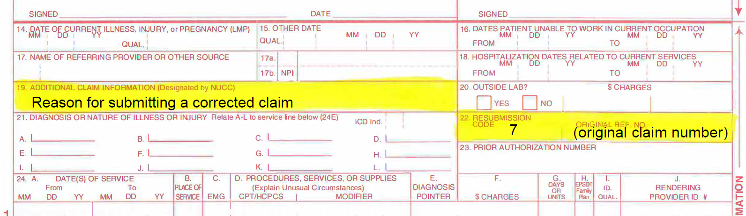
Corrected Claims

Slide 12
Claims Turn Around Time Results
Claims TAT-Annual Review
 | Goal | 2023 | 2024 | Goal 2025+ | 2025
% within 7 days | >50% | 75% | 80% | >85% | 87.4%
% within 10 days | >70% | 87% | 90% | >95% | 95.1%
% within 20 days | >90% | 100% | 100% | >98% | 100%
TAT Paper | <20 days | 7.7 | 7.1 | <20 days | 8.3
TAT Electronic | <15 days | 3.7 | 3.8 | <15 days | 0.9

Slide 13
Claims Inquiries
850-495-3071 or abhbilling@lifeviewgroup.org
Please include the following:
Include the claim number
Member ID
DOS
Service code
Reason for the inquiry

Slide 14
Claim-Related Complaints
A provider has 90 days from the date of the EOB to file a written complaint to ABH
ABH provides written notice of receipt of the complaint within 3 business days
ABH provides written notice of status/outcome every 30 days until resolved
Appeal Process - Refer to EOB cover letter

Slide 15
Keeping up with Medicaid ID status
Growing numbers of providers losing Medicaid status due to Medicaid ID going inactive
This must be reported to ABH as soon as provider is aware
New process:
Once inactive provider will have 30 days to gain Medicaid ID back
After 30 days provider will lose in-network status with ABH and must recredential when ID becomes active again
Contracts/Attestations

Slide 16
Provider Feedback
Fall 2025 provider training feedback: ABH monthly roster report can be difficult
“The provider roster continues to be significantly more burdensome than any other Florida Medicaid plan requires.”

Slide 17

PROVIDER NETWORK VERIFICATION Access Standards & Rosters

Slide 18
Required Network Standards Adequacy Ratios
Adult Psychiatrists per enrollee
Child Psychiatrists per enrollee
LPHAs per enrollee
Hospital/CSU acute & detox beds per enrollee
Community Substance Use Treatment Centers
Required % of Providers Available After-Hours
Required % of Providers Offering Telehealth

Slide 19
Network Standards GeoSpatial Access
Drive Time and Distance Standards:
Adult Psychiatrist
Child Psychiatrist
Licensed Practitioner Healing Arts - LCSW, LMHC, LMFT, Psychologist
Medication Assisted Treatment for opiate dependence (MAT)

Slide 20
Network Provider Rosters
The basis for:
Claims payment
Provider directory
Measuring network adequacy
Secret shopper calls
Roster updates are necessary. Required monthly
Match what's in Medicaid Provider Master List ("PML")
CAQH is Humana's “source of truth"
Column A: change tracking (A, T, M, or N)
"M": Always please highlight any changes

Slide 21
Credentialing Reminder
CAQH should be updated every 120 days
Must re-attest every 120 days

Slide 22
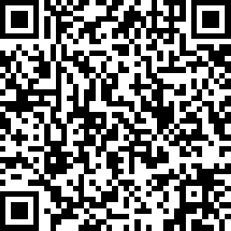
REMINDER:
Please add the following to the chat box:
Name
Title/Credentials
Agency and Location
Email Address
SCAN ME!!

Slide 23
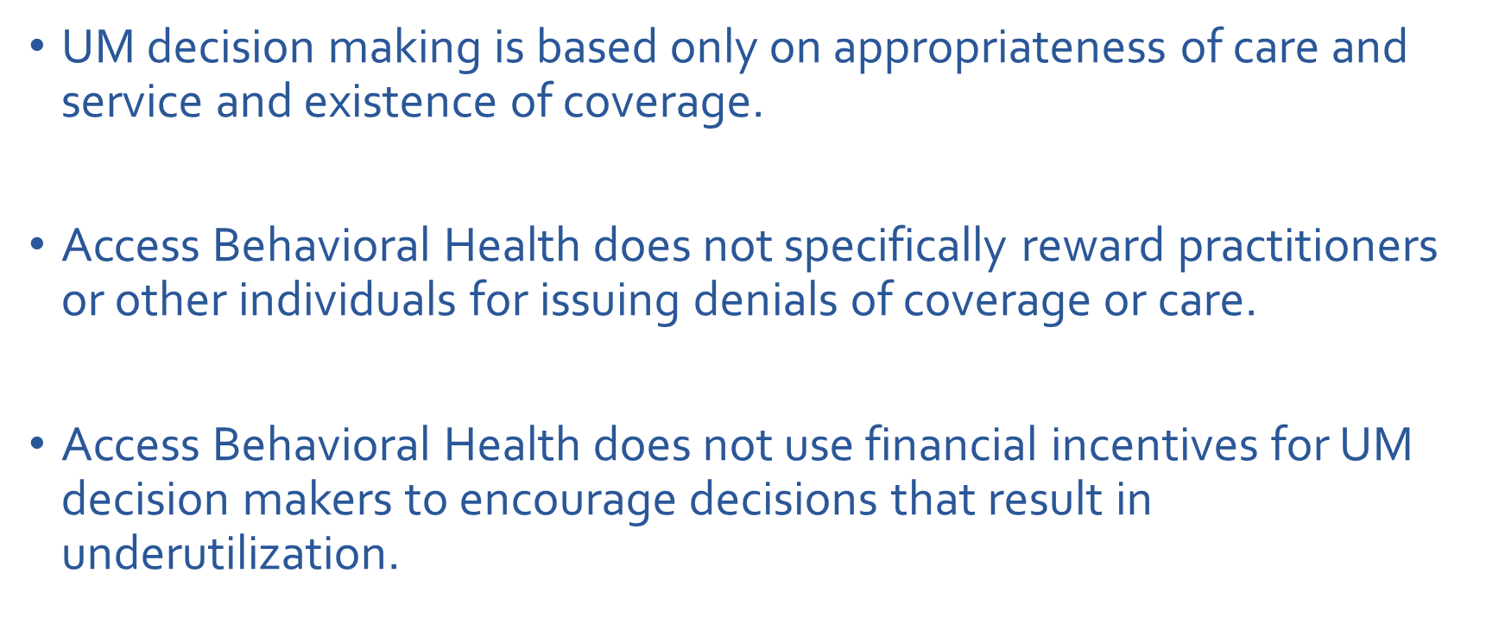
Affirmative Statement

Slide 24
Referral Process - Inpatient
Service Authorization Requirements:
Inpatient
Authorizations should be requested by emailing or faxing clinical information to (850)353-6041 or abhreferral@lifeviewgroup.org
Face sheet,
Assessments that indicate why the member is being hospitalized, and
A Baker Act (if there is one)
Short Term Residential Treatment (SRT)
Minimum Service Coverage Guidelines
A minimum of three (3) days' coverage of emergency behavioral health inpatient services are authorized when care is provided as a result from a Baker Act admission.

Slide 25
Inpatient Utilization: Inpatient Admissions
 | 2023 |  | 2024 |  | 2025
 | Discharges | YoY % | Discharges | YoY % | Discharges | YoY %
Overall | 2123 | -8.21% | 1550 | -26.99% | 1549 | -0.06%
Adults | 1281 | -13.03% | 824 | -35.58% | 789 | -4.25%
Children | 842 | 0.24% | 726 | -13.78% | 760 | -4.68%
Average 1.9 discharges per 1,000 members
Average of 16.6 days per 1,000 members
Average length of stay is 9.3 days per admission

Slide 26
Referral Process - Outpatient
Service Authorization Requirements:
Outpatient services DO NOT require prior authorization
Notification is requested for the following services:
•Psychological Testing
•ECT
•IOP
•PHP

Slide 27
Outpatient Utilization
Averages 55.5 therapy services per 1,000 members
Averages 2.0 Targeted Case Management (TCM) services per 1,000 members
Averages 39.9 med management services per 1,000 members
Telehealth increased 12.49% from 2024 to 2025

Slide 28
Accessibility: Timely Access to Services
Initial Access to Care
Following inpatient: 7 days
Outpatient Therapy: 14 days
Prescriber: 60 days
Follow up Care
Individual/Family Therapy: 81% once per month
Prescriber Appointments: 97% every 180 days
>50% every 30 days

Slide 29
Accessibility: Emergency and Urgent Care
Emergency care will be provided immediately
Urgent Care - within 48 hours

Slide 30
Resources
ABH website – https://abhfl.org
Mobile response teams:
866-517-7766: Escambia/Santa Rosa/Okaloosa/Walton Counties
850-522-4485 x1833: Bay County
800-342-0774: Leon County
Remind clients they have a free transportation benefit
Humana: 866-779-0565
Sunshine (See next slide for more information)

Slide 31
Sunshine Transportation benefit:
MMA Phone number: 1-844-352-0134
CW Phone number: 1-844-352-0414
SMI Phone number: 1-844-352-1485
Transportation for LTC and LTC Comprehensive
Phone number: 888-863-0248
Transportation for Children’s Medical Services
Medical Transport Management (MTM)
Phone number: 844-399-9469

Slide 32
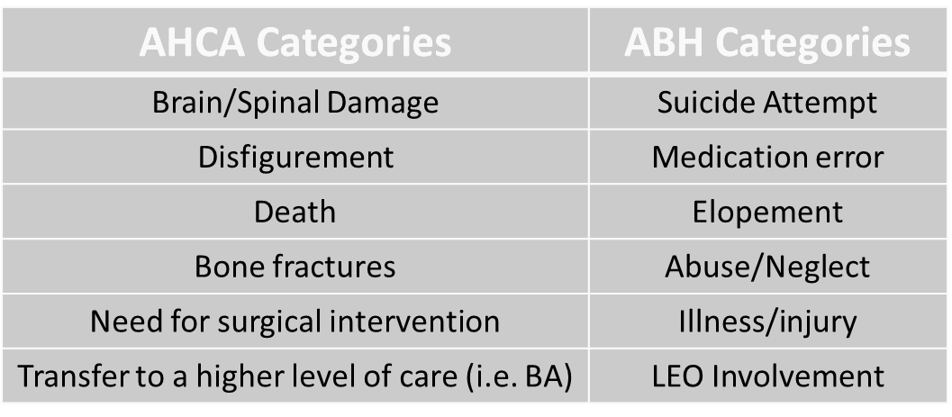
Critical Incidents
All incidents should be reported by email to the ABH Quality team within 24 hours
How to report:
Email: ABHQualityDepartment@lifeviewgroup.org

Slide 33
Evidence Based Practices (EBPs)
EBP Service Description | CPT or HCPCS Code | Modifier
Homebuilders (in home intensive family therapy to prevent out of home placement) | H2022 | U4
Parent Child Interaction Therapy (in home intensive parent support program, court ordered often) | 90837, 90847 | HR (Apply to Each)
Brief Strategic Family Therapy (short term family tx model) | 90847 | HE
Motivational Interviewing (technique to motivate change in behavior) | 90832, 90834, 90837 | HE (Apply to Each )
Multi Systemic Therapy (ILOS) (intensive family tx program for youth with severe conduct problems) | H2033 | N/A
Functional Family Therapy (ILOS) (assists family in changing their interactions to improve behavior) | H0036 | N/A

Slide 34
MRDR: Psychotropic Consent Requirement
13 years or younger
Must include attestation to the pharmacy
Sample attestation: Florida Medicaid Consent Example
Retain x 6 years
Pharmacies may not add refills to old prescriptions to circumvent the need for an updated informed consent form.
Every new prescription will require a new informed consent form.
The informed consent forms do not replace prior authorization requirements for non-PDL medications or prior authorized antipsychotics for children and adolescents under the age of eighteen (18) years.

Slide 35
2025 Audit Results
Psychotropic Consents for members < 13 years
Consent for Psychotropics: Presence of Informed Consent
 | Q1.25 | Q2.25 | Q3.25 | Q4.25
Goal | 90% | 90% | 90% | 90%
Rate | N/A | 25% | 80% | 75%
Numerator/Denominator | 0/0 | 2/8 | 4/5 | 6/8
Consent for Psychotropics: Presence of Attestation to Pharmacy
Goal | 90% | 90% | 90% | 90%
Rate | N/A | 25% | 80% | 75%
Numerator/Denominator | 0/0 | 2/8 | 4/5 | 6/8

Slide 36
Behavioral Health Screenings
Launch Poll

Slide 37
REMINDER:
Please add the following to the chat box:
Name
Title/Credentials
Agency and Location
Email Address
SCAN ME!!

