Slide 1
ABH Network Provider Administrative Training
PRESENTED BY ACCESS BEHAVIORAL HEALTH
April 24 & 25, 2025

Slide 2
Introductions
In the interest of time, ABH presenters will introduce themselves during their sections.
Please introduce yourselves by adding the following to the chat box:
(ALT+ENTER will allow you to do multiple lines of info without sending multiple chats)
Name
Title/Credentials
Agency and Location
Email Address

Slide 3
Closed Captioning
Please enable captions in zoom
  Select “more” at the bottom of your screen
  Select “captions”
  You will now see closed captioning along the bottom of your screen

Slide 4
Housekeeping
Please enter all questions into the “chat” and ABH will monitor those.
Please mute unless you are speaking
Launch Attendance Poll

Slide 5
Opening Remarks
Medicaid Updates
  New state contracts
  Specialty products
  SMI Algorithm
  Quality Withhold
  Claims processing standards
On the Horizon
  Legislative session

Slide 6
20% of youth have a mental health condition, with one in 10 young people having experienced a period of major depression.

Slide 7
Claims Turn around Times
Claims TAT
 | Goal | 2022 | 2023 | 2024 | New Goal
% within 7 days | >50% | 81% | 75% | 80% | >85%
% within 10 days | >70% | 90% | 87% | 90% | >95%
% within 20 days | >90% | 100% | 100% | 100% | >98%
TAT Paper | <20 days | 7.6 | 7.7 | 7.1
TAT Electronic | <15 days | 3.5 | 3.7 | 3.8

Slide 8
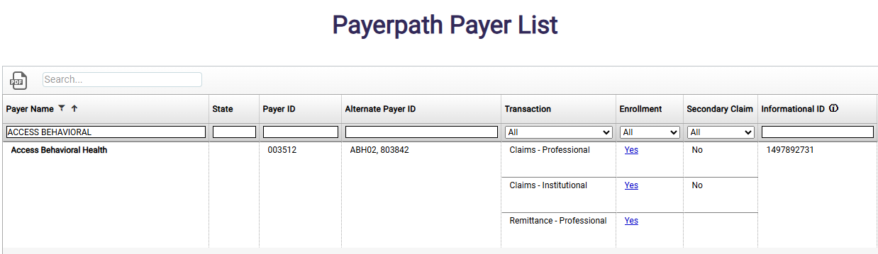
Electronic claims - EDI Gateway
ABH has partnered with Veradigm to increase clearinghouse connectivity via the Payerpath EDI gateway
Payerpath current clearinghouse connectivity includes: Availity, Waystar, Change, Office Ally, TriZetto, Inovalon, and SSI

Slide 9
Claims Payment
Paper Claims Billing address
  Access Behavioral Health
  ATTN: Claims
  1221 West Lakeview Avenue
  Pensacola, FL 32501
Reimbursable behavioral health diagnosis codes:
  F01.50 – F53.1; F55.0 – F63.9; F68.10 – F69; F80.82, F88 – F99; Z03.89
Claims payment questions:
  (850) 469-3631; abhbilling@lifeviewgroup.org
  Linda Gibbs, RHIA, Director of Reimbursement Services
Direct deposit application

Slide 10
Common Denial Reasons
Not a covered diagnosis
  Autism and other developmental disorders are not covered by ABH
    ADOS testing for Autism is not covered by ABH
  Diagnosis not billed to required specificity
No insurance
Service not in provider’s profile

Slide 11
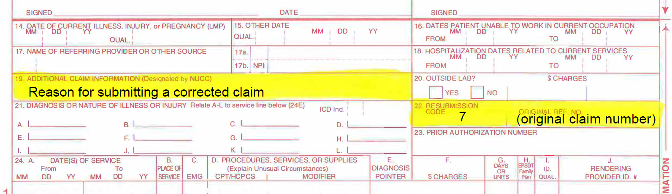
Submitting Corrected Claims

Slide 12
ABH Provider Portal
Requires a brief training/ facility username and password
  Check member eligibility
  Check claims status
  Obtain weekly remittance advice (EOB)
  Direct entry of professional claims on HCFA 1500 form
Contact Jon Hawkins or Jim Hered for assistance/training updates

Slide 13
Affirmative Statement about Incentives
UM decision making is based only on appropriateness of care and service and existence of coverage.
Access Behavioral Health does not specifically reward practitioners or other individuals for issuing denials of coverage or care.
Access Behavioral Health does not use financial incentives for UM decision makers to encourage decisions that result in underutilization.

Slide 14
Thinking about 3D objects
(like when playing Tetris)
has been noted to decrease symptoms of PTSD.

Slide 15

MEDICAID PROVIDER ENROLLMENT &
PROVIDER NETWORK VERIFICATION

Slide 16
Provide Network Verification
Accuracy/Provider Roster Report
Thank You All Working With us to Assure Monthly Roster Updates.
  Change tracking: N / A / T / M / L
  Match a line in the Medicaid PML: NPI, Medicaid ID, type, specialty, & taxonomy
  Web portal link to PML
  CAQH: Humana’s source of truth for service locations
  Shopper calls (health plan, state, DOH, ABH)
  Monthly roster update reports needed
  NPI Search Engine within Medicaid secure provider portal
  Remain alert to Medicaid provider expiration dates
  Medicaid provider ID replacements
Notes:
MIKE

Slide 17
Contract Standards
Network Provider Contracts
  Adherence to Medicaid Handbook requirements
  Medicaid Rates have increased from those in the handbook
  Geographic access & network adequacy
  Telehealth claims: POS 10 = home & 02 = anyplace else (GT added modifier for some Medicaid Handbook services)

Slide 18
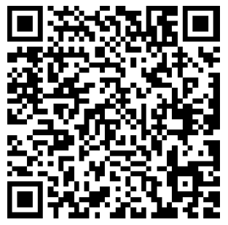
REMINDER:
Please add the following to the chat box
(ALT+ENTER will allow you to do multiple lines of info without sending multiple chats)
Name
Title/Credentials
Agency and Location
Email Address
Also >> SCAN ME!!

Slide 19
Healthcare Effectiveness Data and Information Sets

Slide 20
HEDIS: Medication Measures
Measure ID | Measure Description | YTD Rate | Goal
ADDE Continuation | Follow Up Care for Children Prescribed ADHD Meds - Continuation Phase | 63.64% | 53.57%
ADDE Initiation | Follow-Up Care for Children Prescribed ADHD Meds - Initiation Phase | 35.14% | 46.00%
AMM ACUTE | Antidepressant Medication Management Effective Acute Phase Tx | 52.33% | 62.43%
AMM Continuation | Antidepressant Medication Management - Continuation Phase Tx | 23.83% | 44.25%
SAA Default | Adherence to Antipsychotic Medications for Individuals With Schizophrenia | 72.31% | 62.56%
APP | Use of First-Line Psychosocial Care in Children and Adolescents on Antipsychotics (Total) | 38.89% | 60.22%

Slide 21
HEDIS: Lab Measures
Measure ID | Measure Description | YTD Rate | Goal
APME | APM Blood Glucose and Cholesterol Testing - Metabolic Monitoring for Children and Adolescents on Antipsychotics (Total) | 27.90% | 36.61%
APME | APM Blood Glucose Testing - Metabolic Monitoring for Children and Adolescents on Antipsychotics (Total) | 43.35% | 57.02%
APME | APM Cholesterol Testing - Metabolic Monitoring for Children and Adolescents on Antipsychotics (Total) | 29.18% | 37.80%
SMC Default | Cardiovascular Monitoring for People with Cardiovascular Disease and Schizophrenia (LDL-C) | 60.00% | 79.55%
SMD Default | Diabetes Monitoring for People with Diabetes and Schizophrenia | 73.33% | 71.27%
SSD Default | Diabetes Screening for People With Schizophrenia or Bipolar Disorder Who Are Using Antipsychotic Medications | 83.10% | 81.42%

Slide 22
HEDIS: Mental Illness
Measure ID | Measure Description | YTD Rate | Goal
FUH 30 day | Follow up after hospitalization for Mental Illness 30 days | 61.60% | 59.85%
FUH 7 day | Follow up after hospitalization for Mental Illness 7 days | 42.71% | 36.94%
FUM 30 day | Follow up after Emergency Department for Mental Illness 30 days | 48.00% | 53.82%
FUM 7 day | Follow up after Emergency Department for Mental Illness 7 days | 44.33% | 38.62%

Slide 23
HEDIS: Substance Use
Measure ID | Measure Description | YTD Rate | Goal
FUA 30 day | Follow up after Emergency Department for Substance Use Disorder30 days | 34.83% | 36.18%
FUA 7 day | Follow up after Emergency Department for Substance Use 7 days | 24.16% | 24.00%
IET Engagement | Engagement of Alcohol/Other Drug Use Tx | 5.76% | 14.39%
IET Initiation | Initiation of Alcohol/Other Drug Use Tx | 35.83% | 44.51%
FUI 30 day | Follow up after High Intensity Care for Substance Use Disorder 30 days | 20.75% | 53.28%
FUI 7 day | Follow up after High Intensity Care for Substance Use Disorder 7days | 3.77% | 32.34%

Slide 24
Members of the LGBTQ community are twice as likely as straight individuals to have a mental health condition.

Slide 25
2024 ABH Annual Evaluation Results

Slide 26
Network Adequacy:
Cultural Needs & Preferences
Importance of including language on roster
No network adjustment necessary
 | 2023 | 2024
Provider Spanish Speaking | 6% | 5%
Member Spanish Speaking | 3.4% | 3.8%

Slide 27
Network Adequacy:
Cultural Needs & Preferences
Ethnic Distribution | Provider |  |  | Member
 | 2023 | 2024 |  | 2023 | 2024
African American | 17% | 17% |  | 15% | 15%
Hispanic | 7% | 8% |  | 26% | 26%
White (Non-Hispanic) | 62% | 57% |  | 52% | 52%
Other | 14% | 18% |  | 4% | 4%

Slide 28
Network Adequacy:
Cultural Needs & Preferences
Member Experience Survey Results (goal 4.5)
Survey Question | 2023 | 2024
My counselor is a good match for me. | 4.6 | 4.6
Information is given to me in a language I understand | 4.8 | 4.7
The staff are sensitive to my cultural/ethnic background | 4.5 | 4.5

Slide 29
Ensuring Availability: Geographic Access
Urban Standard: 20 miles
Rural Standard: 45 miles
Specialists | 2022 | 2023 | 2024
Adult Psychiatrist | 99% | 99% | 100%
Child Psychiatrist | 99% | 99% | 100%
Licensed Practitioner | 99% | 99% | 100%
Specialists | 2022 | 2023 | 2024
Adult Psychiatrist | 100% | 100% | 100%
Child Psychiatrist | 100% | 100% | 100%
Licensed Practitioner | 100% | 100% | 100%

Slide 30
Depression is responsible for more missed work hours than arthritis or cancer.

Slide 31
Accessibility: Timely Access to Services
Initial Access to Care
  Secret Shopper Calls
Follow up Care
  Individual/Family Therapy
  Prescriber Appointments
Phone Standards
  Calls Abandoned
  Average Speed of Answer

Slide 32
Initial Access to Care: Secret Shopper Calls
Non life-threatening emergency: 6 hours
Urgent care: 48 hours
Hospital Follow up: 7 days
Initial Therapy: 14 days
Initial Prescriber: 60 days
100% of providers met all standards for each quarter in 2024
2024 | # Secret Shopper Calls Made
Provider Type | Q1.24 | Q2.24 | Q3.24 | Q4.24
Non-Prescribers | 39 | 28 | 24 | 22
Prescribers | 28 | 16 | 10 | 16

Slide 33
Timely Access to Follow Up Care
2024 | Percent of appointments that are within follow-up standards
Service Type | Goal | Q1 | Q2 | Q3 | Q4
Individual/Family Therapy | 30 days | 92.2% | 91.4% | 87.78% | 88.5%
Medication Management | 180 days | 98.0% | 97.5% | 97.74% | 95.2%

Slide 34
The body's supply of serotonin, the hormone involved in the regulation of a person's mood, is actually located in the gastro-intestinal tract rather than the brain.

Slide 35
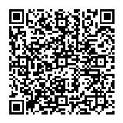
Network Adequacy:
New Contract Requirement
We anticipate a possible roster format update
After Hours-services between 5pm-8am and/or weekends.
Inclusive of telehealth and in person.
Categories:
  Prescriber
  Other outpatient services
Notes:
https://zoom.us/survey/du5q2rCcIn-mMlibSNy1YlD0LMc7cGoVxsDws6kgVXMMQBKjxoc.dled5hzj4Vg75xf9/view?id=xJa5WGDfR3WbFQCL6AnC_w#/sharePreview

Slide 36
Provider Satisfaction Survey
Survey to assess Provider Satisfaction with ABH UM
2025 survey will be sent to providers this Friday by Humana
Year | Result | Goal | N
2024 | 3.91 | 4.3 | 48
2023 | 4.13 | 4.3 | 44
2022 | 4.25 | 4.2 | 70

Slide 37
Member Experience Survey
Category | Goal | 2022 | 2023 | 2024
Services | 4.5 | 4.4 | 4.4 | 4.5
Accessibility | 4.5 | 4.4 | 4.4 | 4.5
Availability | 4.5 | 4.6 | 4.7 | 4.6
Acceptability | 4.5 | 4.5 | 4.5 | 4.5
Overall Satisfaction | 4.5 | 4.5 | 4.6 | 4.6

Slide 38
Member Inquiries and Complaints
Polls:
What do members ask about the most?
What do members complain about the most?

Slide 39
Member Safety
Category | 2022 | 2023 | 2024
Quality of Care | 0 | 0 | 0
Enrollee Death | 11 | 8 | 3
Enrollee Homicide | 0 | 0 | 0
Elopement | 174 | 38 | 10
LEO Involvement | 19 | 14 | 11
Other Reportable Incident | 24 | 13 | 12

Slide 40
ABH Audits & Provider Information

Slide 41
Medical Record Audits
Medical Records Documentation
  Highest Scores: Individual/Family Therapy
  Lowest Scores: In Depths/Justification & Targeted Case Management Assessments
  Coordination of Care
    BH to BH 100%
    BH to Medical: 99%

Slide 42
Medical Record Audits
Psychotropic Medication New Requirement
Must be present in chart: Documentation of the express written and informed consent for psychotropic medication (i.e., antipsychotics, antidepressants, antianxiety medications, and mood stabilizers)
Member is younger than 13 years old
The informed consent forms do not replace prior authorization requirements for non-PDL medications or prior authorized antipsychotics for children and adolescents under the age of eighteen (18) years.

Slide 43
Call Center and Claims Audits
Call Center: Scored 100% every month in 2024
Claims
  Procedural Accuracy: 100% every month
  Financial Accuracy: 100% every month

Slide 44
Escambia County experiences more admissions for Baker Acts, compared to the state between
2019-2023 (FL Dept of Health)

Slide 45
Credentialing Actions
Providers continue to join the ABH network in 2024:
  3 new provider organizations
  5 new practitioners
  0 denied applicants
  3 practitioners left the network
Provider directory updated within 30 days to reflect newly credentialed provider information

Slide 46
2025 Directory Accuracy & Usability
2025 Survey will be going out following this training
  Due to many errors being found on our directory after our last survey— we will be conducting it again!
Behavioral Health Screenings/Clinical Practice Guidelines are located on the ABH website under 'Wellness Tools'
  CPG literature is reviewed/updated every 2 years.
  Next review will be in 2026. Last review was 3/12/24

Slide 47
ABH Quality
Quality Improvement Program Description
Quality Subcommittee (2x/year)
Credentialing Subcommittee (as needed)

Slide 48
REMINDER:
Please add the following to the chat box
(ALT+ENTER will allow you to do multiple lines of info without sending multiple chats)
Name
Title/Credentials
Agency and Location
Email Address
Also >> SCAN ME!!

Slide 49
Interrater Reviewer Reliability
2024 |  | Reviewer Accuracy Rate
Reviewer Name | Reviewer Profession | Q1 | Q2 | Q3 | Q4
Mobley, Ed | Physician | . | . | - | 100%
Conrad, Michael | Physician | . | . | - | -
Dillon, Vincence | Physician | . | . | - | -
King, Katie | Nurse | 100% | 100% | 100% | 100%
DeGraaf, Ruth | Nurse | 100% | 100% | 100% | 100%
Greenway, Rochelle | Nurse | 100% | 100% | 100% | 100%
Raulston, Tara | LMHC | 100% | 100% | 100% | 100%
Beach, Rebecca | LMHC | 100% | 100% | 100% | 100%
Reviewer Profession | Goal | 2022 | 2023 | 2024
Physician | 90% | 100% | 100% | 100%
Nurse | 90% | 100% | 100% | 100%

Slide 50
Referrals and Authorizations
2024 | Jan | Feb | Mar | Apr | May | Jun | Jul | Aug | Sep | Oct | Nov | Dec
Referrals | 157 | 135 | 139 | 153 | 154 | 127 | 117 | 159 | 154 | 164 | 143 | 123
Urgent Concurrent | 152 | 133 | 135 | 148 | 146 | 123 | 113 | 156 | 151 | 162 | 137 | 120
Urgent Preservice | 0 | 0 | 0 | 1 | 0 | 0 | 0 | 0 | 1 | 0 | 0 | 0
Nonurgent Preservice | 2 | 0 | 0 | 0 | 1 | 1 | 0 | 0 | 0 | 0 | 0 | 0
Postservice | 3 | 2 | 4 | 4 | 7 | 3 | 4 | 3 | 2 | 2 | 6 | 3
Authorizations | 157 | 135 | 139 | 153 | 154 | 127 | 117 | 159 | 154 | 164 | 143 | 123
Standard | 5 | 2 | 3 | 6 | 8 | 4 | 4 | 3 | 3 | 2 | 6 | 3
Expedited | 152 | 133 | 136 | 147 | 146 | 123 | 113 | 156 | 151 | 162 | 137 | 120

Slide 51
Denials: Annual Review
 | 2022 | 2023 | 2024
Medical Necessity Denials | 0 | 1 | 0
(Inpatient) Urgent Concurrent | 0 | 1 | 0
Urgent Preservice | 0 | 0 | 0
Nonurgent Preservice | 0 | 0 | 0
Postservice | 0 | 0 | 0
Denial Timeline Compliance | . | 100% | .
Administrative Denials | 0 | 0 | 0
(Inpatient) Urgent Concurrent | 0 | 0 | 0
Urgent Preservice | 0 | 0 | 0
Nonurgent Preservice | 0 | 0 | 0
Postservice | 0 | 0 | 0

Slide 52
Inpatient Utilization: Inpatient Admissions
 | 2023 |  | 2024
 | Discharges | YoY % | Discharges | YoY %
Overall | 2123 | -8.21% | 1550 | -26.99%
Adults | 1281 | -13.03% | 824 | -35.58%
Children | 842 | 0.24% | 726 | -13.78%
Average 1.9 discharges per 1,000 members
Average of 14.8 days per 1,000 members
Average length of stay is 8.2 days per admission

Slide 53
Outpatient Utilization
Averages 40.9 therapy services per 1,000 members
Averages 1.6 TCM services per 1,000 members
  Continual decrease annually
Averages 23.9 med management services per 1,000 members
Telehealth continues to decline annually (- 13.37%)

Slide 54
Claims Volume by provider type
Highest Volume to lowest:
Capitated Providers (4.3%)
Other Providers (-12.83%)
Non-HCA Hospitals (-10.84%)
HCA Hospitals (-43.06%)

Slide 55
Average Membership
 | 2023 |  | 2024
 | Members | YoY % | Members | YoY %
Overall | 133673 | -13.57% | 103209 | -22.79%
Adults | 58091 | -18.51% | 38479 | -33.76%
Children | 75582 | -12.56% | 64729 | -14.36%

Slide 56
Future Clinical Training Topics
Launch poll:
  Please rank your interest in the following topics for future presentation

Slide 57
For every 100,000 people, there are 135 behavioral/mental health professionals working in Escambia County compared to 133 for the rest of Florida.

Slide 58
SOCIAL MEDIA’S IMPACT ON CHILDREN AND ADOLESCENTS’ MENTAL HEALTH
Dr. Mobley – ABH Clinical Medical Director

Slide 59
THE GOOD: A 2022 PEW POLL OF TEENS
SOCIAL MEDIA HELPS:
Teenagers feel more accepted (58%)
Feel like they have people who can support them through tough times (67%)
Feel that they have a place to show their creative side (71%)
Feel that they are more connected to what’s going on in their friends’ lives (80%).

Slide 60
KIDS, PARENTS AND SOCIAL MEDIA
In the USA alone, a 2018 study shows that 93% of youth aged 14-22 use social media including platforms like Snapchat, Instagram, Facebook, and Twitter
COVID drove its use up
83% of kids use it daily
30% of 5 to 7-year-olds who use social media are unsupervised*
A significant percent of parents let kids use it before the legal age*
As kids grow into their mid to later teens, supervision drops with freedom
Kids are curious without well formed judgement or any idea of what bad things are out there
Streaming, chat, texting, sending pictures, movies is a breeze
*2. Ofcom.org.uk

Slide 61
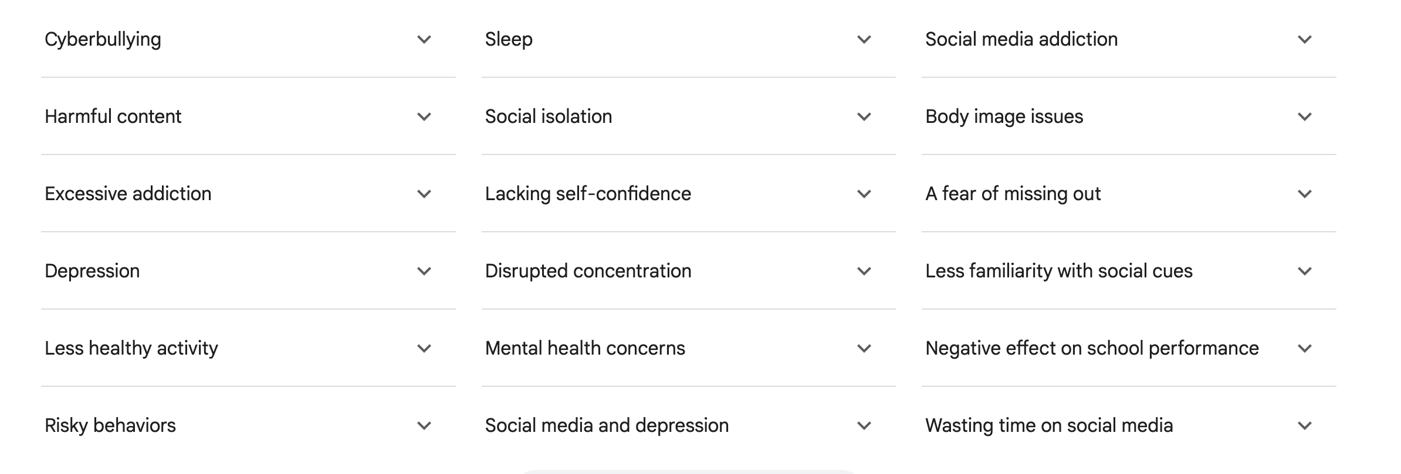
NEGATIVE EFFECTS OF SOCIAL MEDIA
(From sources across the web)

Slide 62
NEGATIVE EFFECTS OF SOCIAL MEDIA
American teens ages 12-15, those who used social media over three hours each day faced twice the risk of having negative mental health outcomes, including depression and anxiety symptoms
Social media algorithms are built to promote whatever you seem interested in. Misinformation and mischief and the dark side of the web follow
Accessing extreme, inappropriate, pornographic and harmful content is easy.
Deaths have been linked to suicide- and self-harm-related content, (“cutting,” partial asphyxiation, and risk-taking challenges)
Studies also found that discussing or showing this content can normalize these behaviors.
Retards normal social development, relationships and communications. Easy to say insulting things at a distance and not when your with someone
1. Yale Medicine

Slide 63
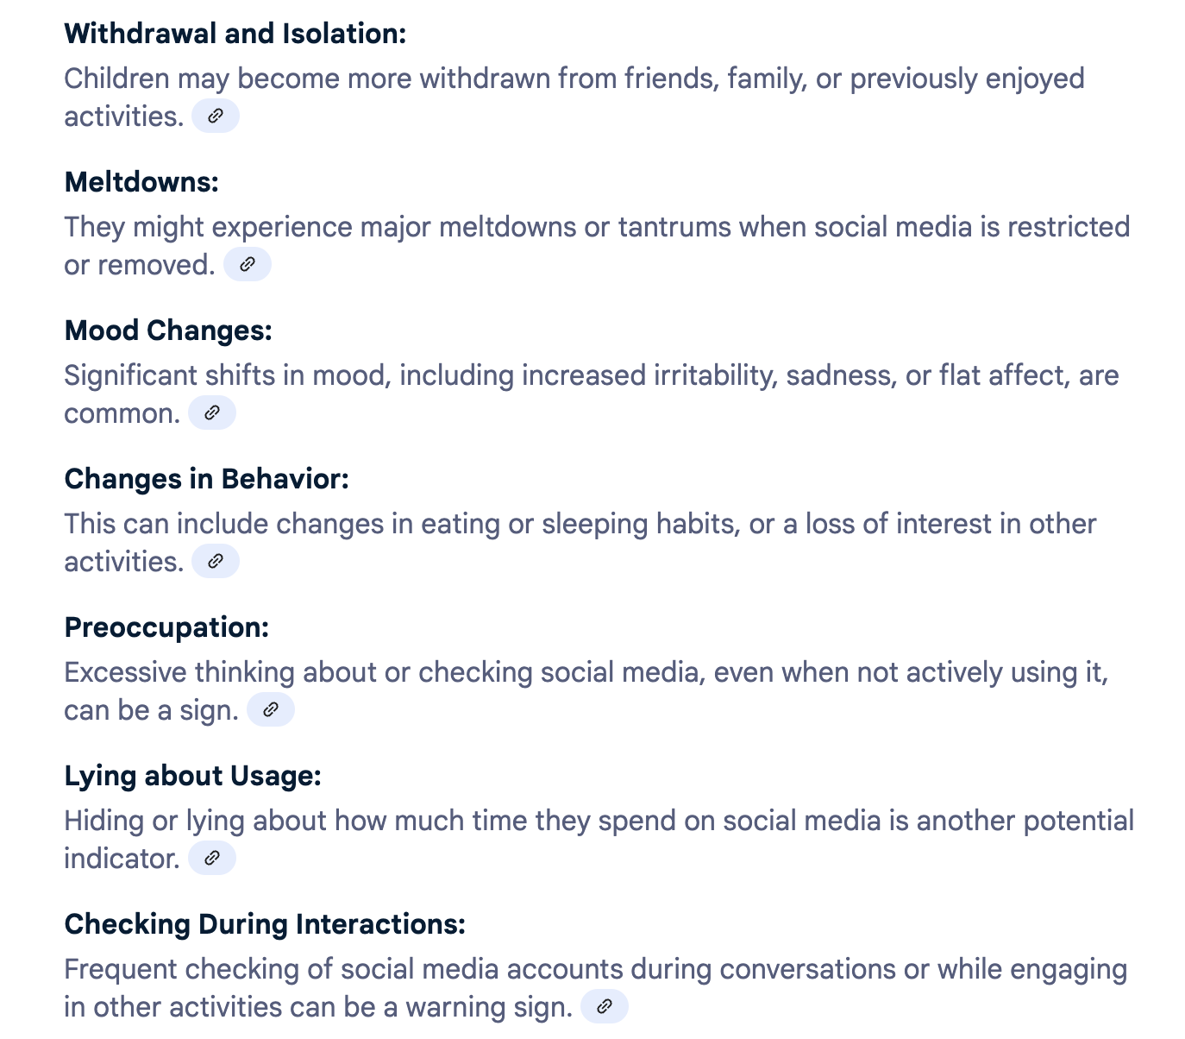
NEGATIVE EFFECTS OF SOCIAL MEDIA
Recognizing the Signs:
4. Sources across the web

Slide 64
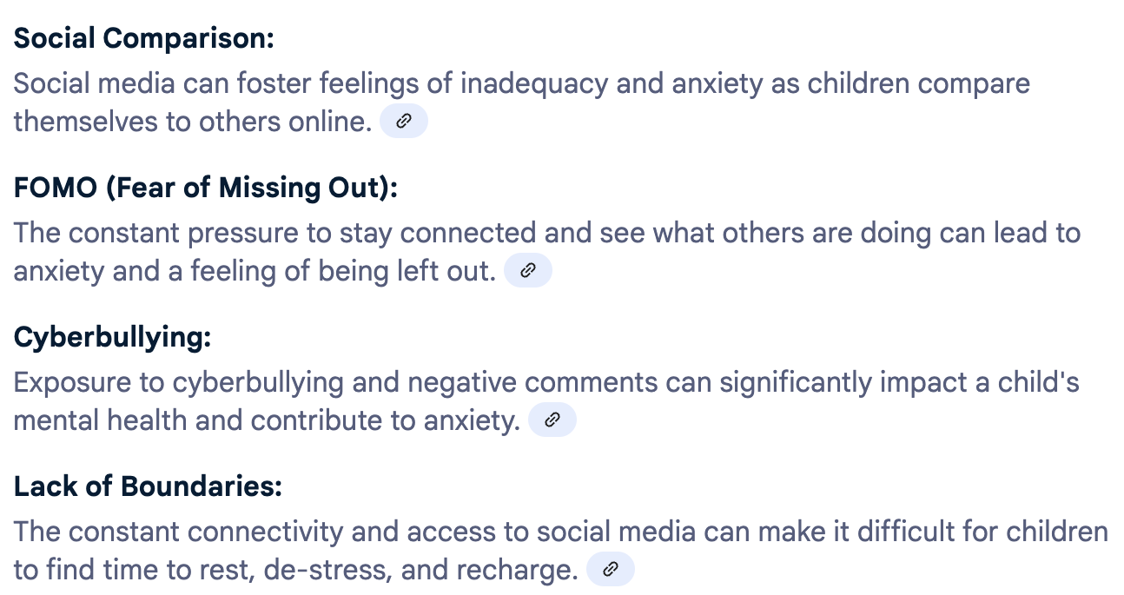
NEGATIVE EFFECTS OF SOCIAL MEDIA
Understanding the impact:
4. Sources across the web

Slide 65
NEGATIVE EFFECTS OF SOCIAL MEDIA
A BYU annual survey from 2009 to 2019, researchers tracked the media use patterns and mental health of 500 teens
Findings in regard to suicide:
Social media use had little effect on boys
Suicidality risk for girls there was a tipping point. Girls who used social media for at least two to three hours per day at the beginning of the study—when they were about 13 years old—and then greatly increased their use over time were at a higher clinical risk for suicide as emerging adults.
3. BYU

Slide 66
NEGATIVE EFFECTS OF SOCIAL MEDIA
Research shows that girls, and women in general, are very relationally attuned and sensitive to interpersonal stressors, and social media is all about relationships
At 13, girls are just starting to be ready to handle the darker underbelly of social media, such as FOMO (fear of missing out), constant comparisons and cyberbullying. A 13-year-old is probably not developmentally ready for three hours of social media a day
Therapeutic point: Always talk to teens, females especially, about suicide when working with emotional issues related to social media
3. BYU

Slide 67
CO-OCCURRING PSYCHIATRIC DISORDERS THAT MAY ACCOMPANY EXCESSIVE SOCIAL MEDIA USE
Eating disorders
Substance abuse
Video game addiction
Anxiety
Depression
Sleep deprivation
Suicide
Trauma
Loss and grief
PTSD
Mood disorders
Obsessive-compulsive disorder
5. Social Victims Media Law Center
5. Social Victims Media Law Center

Slide 68
TIPS FOR THERAPISTS
Learn the adverse impacts of social media on kids and include them in your standard interview
Remember: 93% of kids are using it
Be cognizant that some conditions may be amenable to medication and inpatient treatment and make appropriate referrals
Though DSM 5 does not include it in addictions, there are parallels that may guide therapy

Slide 69
TIPS FOR THERAPISTS:
Therapies with proven success
Cognitive behavioral therapy
Dialectical behavior therapy
Psychodynamic therapy
Exposure therapy
Grief counseling
Somatic therapy
Art and music therapy
Interpersonal therapy
Psycho-educational therapy
Motivational interviewing
Trauma therapy
Medication (both psych and for eating disorders)

Slide 70
TIPS FOR PATIENTS AND PARENTS
Turn off all notifications from social media platforms
Check social media at scheduled times
Limit social media sessions to 30 minutes at a time.
Protect sleep. Avoid screen time during the last two hours preceding bedtime
Avoid engaging with negative posts and users
Avoid damaging misinformation. Think through, don’t just accept. Fact check
For parents: Supervise. Have open discussions with kids. Stop adverse behaviors. Ok to say “N0.” When it’s out of control, it’s ok to get control
5. Social Victims Media Law Center

Slide 71
FINAL THOUGHTS
Kids are easy prey for scammers, pedophiles, pornographers and pervs
Gang recruitment
Dating someone sight unseen
Mischievousness to Murder
Easy for an 11-year-old to click the button and suddenly be 18 years old
An ounce of prevention is worth a pound of cure in this case

Slide 72
Resources:
1.Yale Medicine Kathy Katella June 17, 2024
https://www.yalemedicine.org/news/social-media-teen-mental-health-a-parents-guide
2. Ofcom.org.uk
3. BYU News Christie Allen. February 2022
https://news.byu.edu/intellect/10-year-byu-study-shows-elevated-suicide-risk-from-excess-social-media-time-for-young-teen-girls
4.AI generated sources across the web https://www.google.com/search?q=diagnosis+social+media+induced+anxiety+in+kids&oq=diagnosis+social+media+induced+anxiety+in+kids&gs_lcrp=EgZjaHJvbWUyBggAEEUYOdIBCTE3Njk5ajBqMagCALACAA&sourceid=chrome&ie=UTF-8
5. Social Victims Media Law Center
https://socialmediavictims.org/social-media-addiction/treatment/#:~:text=Turn%20off%20all%20notifications%20from,with%20negative%20posts%20and%20users.

Slide 73
REMINDER:
Please add the following to the chat box
(ALT+ENTER will allow you to do multiple lines of info without sending multiple chats)
Name
Title/Credentials
Agency and Location
Email Address
Also >> SCAN ME!!

