Slide 1
Holistic Care of the Elderly
Ed Mobley, MD
Medical Director of Access Behavioral Health

Slide 2
Core Domains of Holistic Care
Physical Health (Body)
Mental & Cognitive Health (Mind)
Emotional/Psychological Well-being (Mind/Heart)
Social Connection (Community)
Spiritual Well-being (Spirit)
Environmental Safety (Surroundings):

Slide 3
One Size Does Not Fit All
Because Senior Citizens range from
“Sharp as a tack” to various stages of cognitive impairment to frankly demented
“Healthy as horse” to multiple well treated chronic illnesses to ill and in poor health
“Spry as a spring chicken” to various stages of mobility impairment ranging from slow to needing an assistive device to a wheelchair to bedridden
Gregarious and outgoing to seclusive or withdrawn
Thorough and careful assessment coupled with a personalized approach to each person must be taken

Slide 4
Physical Health (Body):
Focuses on managing chronic conditions
Being vigilant for acute illnesses
Nutrition
Hydration
Exercise/mobility
Medication management
Maintain independence vs assist if confused in taking meds
Compliance is what counts

Slide 5
The Beers Criteria.
Caretakers are on the frontlines of the “safety net” of doctors and pharmacists
Medications to Avoid: Drugs that should generally be avoided by most older adults due to high risk.
Disease-Specific Avoidance: Medications that can worsen specific existing conditions, such as heart failure or dementia.
Use with Caution: Drugs that may be necessary but require close monitoring for side effects.
Drug-Drug Interactions: Dangerous combinations that can lead to severe adverse reactions when taken together.
Renal (Kidney) Adjustments: Medications that need different dosing—or should be avoided entirely—based on how well the patient's kidneys function.

Slide 6
Mental & Cognitive Health (Mind)
Involves stimulating brain activity
Managing cognitive decline (e.g., dementia care),
Addressing neurological health.

Slide 7
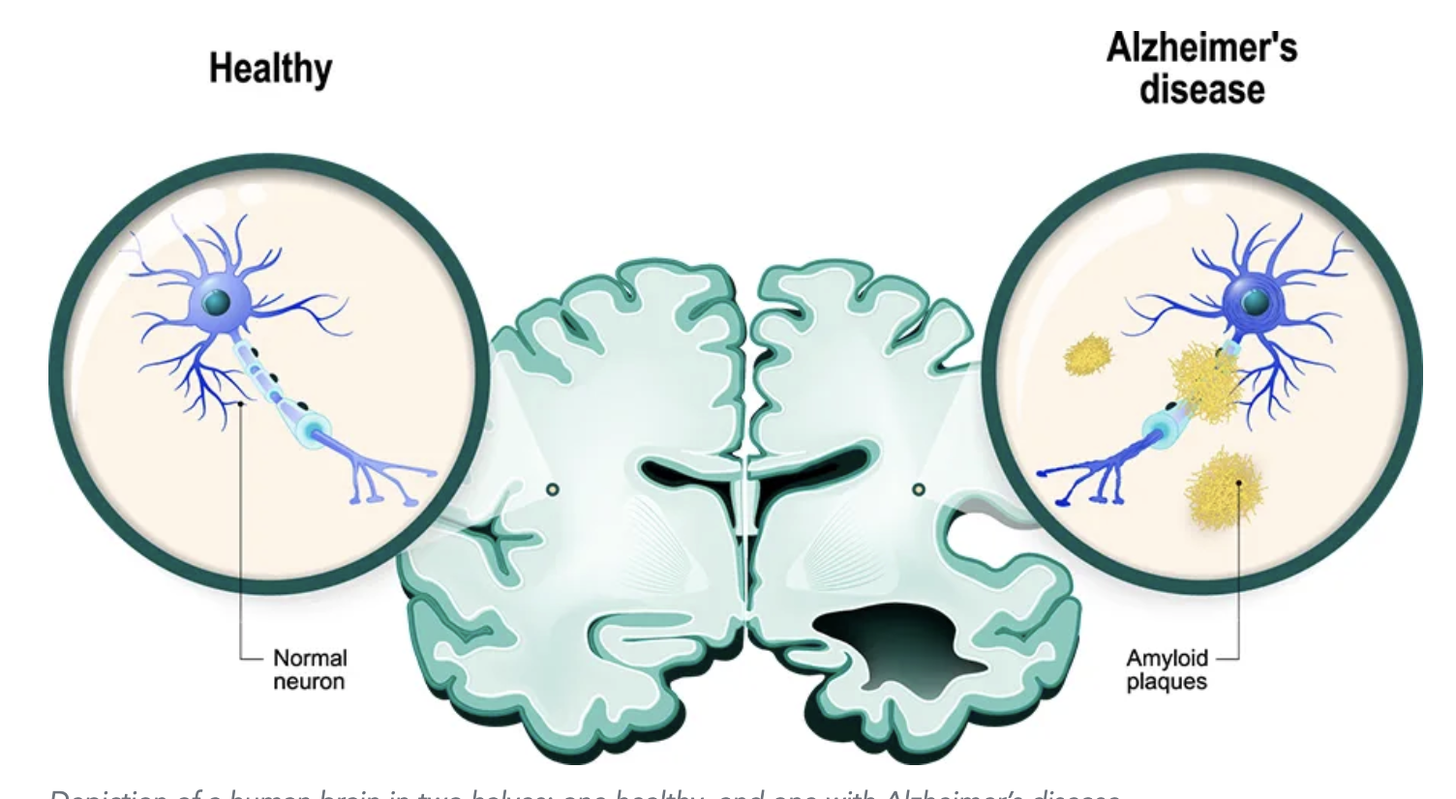
Amyloid Plaques

Slide 8
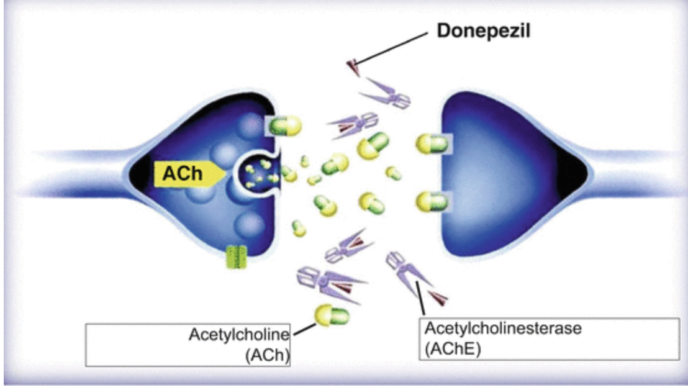
Cholinesterase, Acetylcholinesterase, Donepezil

Slide 9
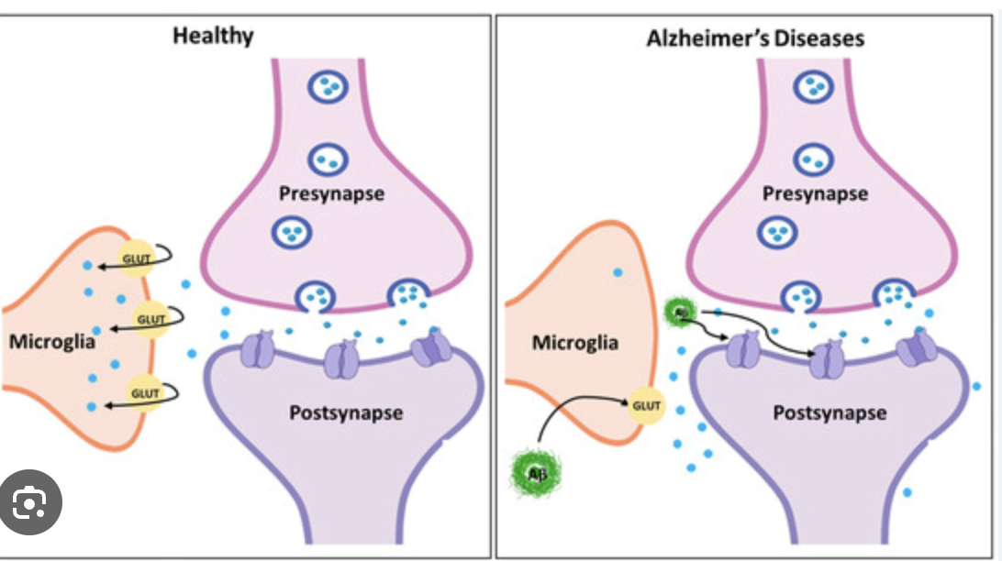
Glutamate and Namenda

Slide 10
Emotional/Psychological Wellbeing & (Mind/Heart)
Social Connection (Community)
Address mental health through therapy, counseling, careful use of medications
Activities like meditation or art to reduce depression and anxiety.
Prioritizes interaction with family, friends, and the community
Prevent isolation and enhance a sense of belonging.

Slide 11
Spiritual Wellbeing (Spirit)
Supports personal values
Religious practices
Existential needs
Aiding in coping with illness and finding meaning.

Slide 12
Environmental Safety (Surroundings)
Ensures the living space is safe, comfortable, accessible, and supportive of the senior's lifestyle.
Fall prevention

Slide 13
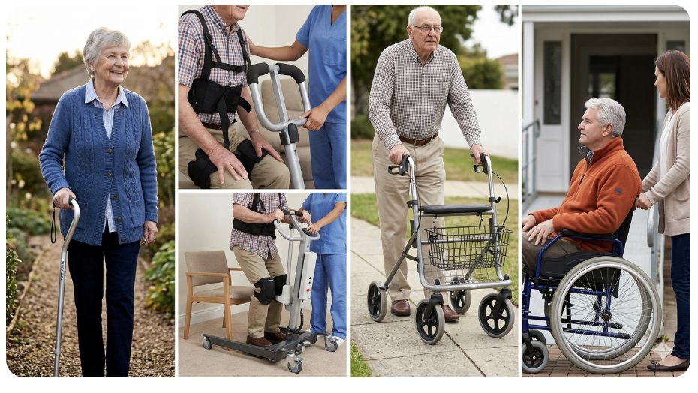
Mobility-Assisting Devices for Home Use

Slide 14
… When I get older losing my hair
Many years from now
Will you still be sending me a Valentine
Birthday greetings, bottle of wine?
If I'd been out 'til quarter to three
Would you lock the door?
… Will you still need me, will you still feed me
When I’m 64………. or 74 or 84 or 94 or 104?

Slide 15
Decisions, Decisions
If you find you can no longer manage these things, it may be in the best interest of your loved one to move to assisted living for their own benefit
Bathing (cleaning themselves in a bath or shower)
Dressing (getting dressed and choosing appropriate clothing)
Toileting (going to the bathroom)
Transferring (the ability to get in and out of bed)
Continence (bladder and bowel control)
Eating (feeding themselves, including handling utensils, swallowing, proper nutrition)
You just don’t have the stamina or physical ability to do what’s necessary
You’ve run out of patience and are mentally fatigue

